Slide 1
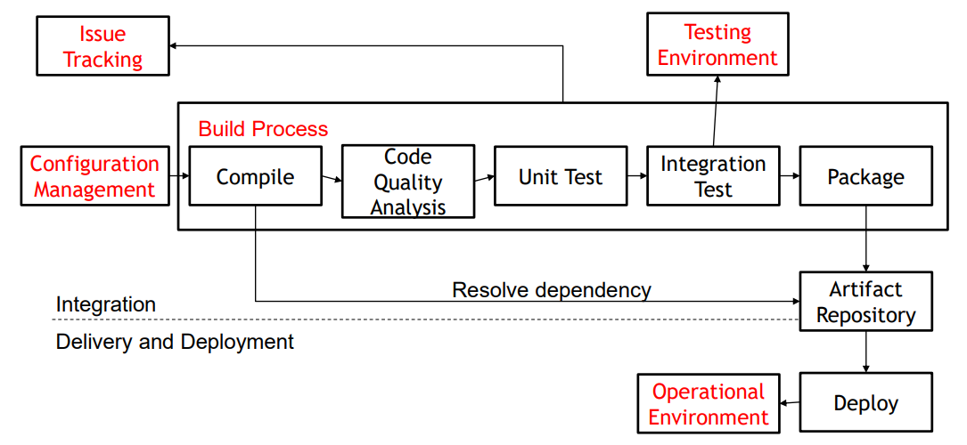
DevOps
Make the process from develop to deploy a software application faster through the automation
Integrate processes between development and operation
Automate the thing that be done manually in the past
Emphasizes continuous Integration and continuous delivery/deployment(CI/CD), therefore maximum efficiency
Notes:
Many teams worldwide use Ansible for orchestration while Jenkins is used for build and release automation.

Slide 2
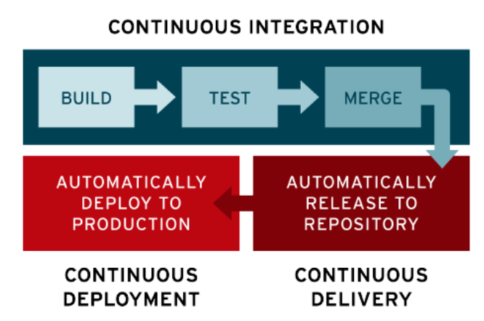
CI(Continuous Intergration)/CD(Continuous Delivery/Deployment)

Slide 3
Outline
Configuration Management
Issue Tracking
Build Process
Test Environment
Oprational Environment

Slide 4
Configuration Management
Configuration and then manage items in order for the project to be successful.
Without Configuration Management, artifacts and other useful information will be all over the place
Tools : Chef, Puppet, Ansible
Configuration Control
Change Management Process
change
Configuration Identification
continuously check if changes occur
configuration items been identified
source code
binary code
server
tool
Configuration Audit
audit once in some interval to check if some changes bypass configuration control

Slide 5
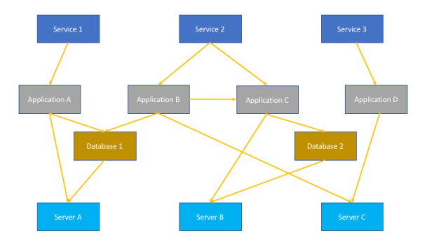
Configuration Management
Component
Source Code Repository(development phase)
anything that is a human readable goes into the source code repository( Test scripts, actual code, and config files, etc.)
DVCS : Git, Mercuria
CVCS : Subversion, CVS(CVCS)
Artifact Repository(development&operations phases)
stores machine files(e.g. binaries, test data, libraries)
Configuration Management Database(development and operations phases)
particularly useful in changes management
Incident Management

Slide 6
Issue Tracking
In Traditional
Spreadsheets were used to organize and manage the issues which were identified in the system.
Issue Tracking tools have long been used by the companies to measure the quality of the software products, where the main objective was to identify all possible defects and bugs in the system.
In DevOps
Keeping track of the changes, schedule and prioritize issues, and assigning them to the relevant members, and generate comprehensive reports as well.
A customizable platform to track the progress of the issues and use valuable metrics.
Reduces the workload of the team by eliminating the need for performing tedious task
Detect bugs and issues in the application in the early stages of the development and preventing them from snowballing into larger problems saves substantial time and costs for the company.
Providing a platform that helps to bridge the gap between the QA team and the developers.

Slide 7
Issue Tracking
keep track of the changes that occur in your CI/CD pipelines
detect bugs and issues in the application in the early stages of the development and preventing them from snowballing into larger problems
facilitates the testers to identify the prevailing problems in the application
offers testers a customizable platform to track the progress of the issues and use valuable metrics
e.g. sends notifications and reminders to the relevant team members if an issue or bug is detected in the application
Tools
Mantis Bug Tracker
WhiteSource Bolt
Snort
OverOps

Slide 8
Build Process
To build the source code into some desired format and to automate the task of cleaning, compiling, testing, and deploying to a certain location
Build Automation Tools
Maven(Java)
Grunt(JavaScript)
A-A-P(Python)
Code Quality Suggestion tools
Cobertura(Java)
Coverage.py(Python)
Jasmine(JavaScript)

Slide 9
Build Process(Unit test v.s. Integration test)
Encapsulation: While unit tests are well encapsulated and don't use external resources, integration tests use additional components or infrastructures like the network, database, or file system.
Complexity: Unit tests target small and distinct parts of code, so they are usually simple to write. Integration tests are more complex, often requiring tooling and setting up different infrastructures.
Test failure: When a unit test fails, there is clearly a bug in the business logic of the code. When an integration test fails, you shouldn't need to look at the code that implements business logic; the unit tests should flush out bugs at that level. It's more likely that something has changed in the environment and needs to be addressed.

Slide 10
Testing Environment
The environment that you use to do integration Testing, it should be similar to your operational so the integration test can simulate how your product behave
Unit Testing Tools
JUnit(Java)
PowerMock(Java)
Pytest(Python)
Integration Testing Tools
Selenium
Testsigma
IBM Rational Functional Tester

Slide 11
Testing Environment
A server that allows you to run the test cases you have defined.
Involving hardware and network configuration.
Providing accurate feedback about the quality and the behavior of the application under test.

Slide 12
Operational Environment
Application Server
Tools
The backend framework we use may provide the ability to install an application server
Use container or VM to run the application server
Tools
Docker

